Slide 1
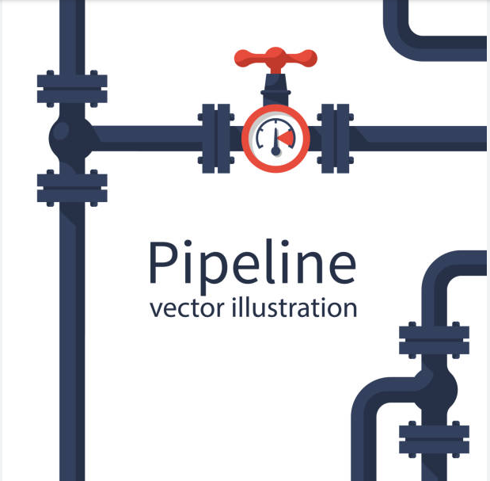
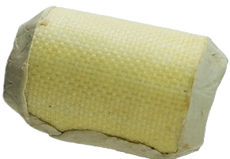


Retrieval-Augmented Generation in a Low Lexical Diversity Scenario
Applied Data Science Project 20/02/2025
Team 1: Minal Jamshed, Prima Acharjee, Michele Panteleo

Slide 2




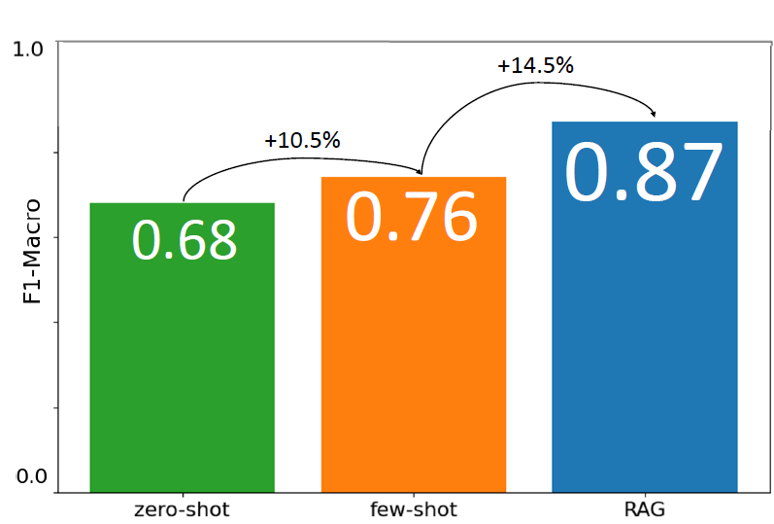
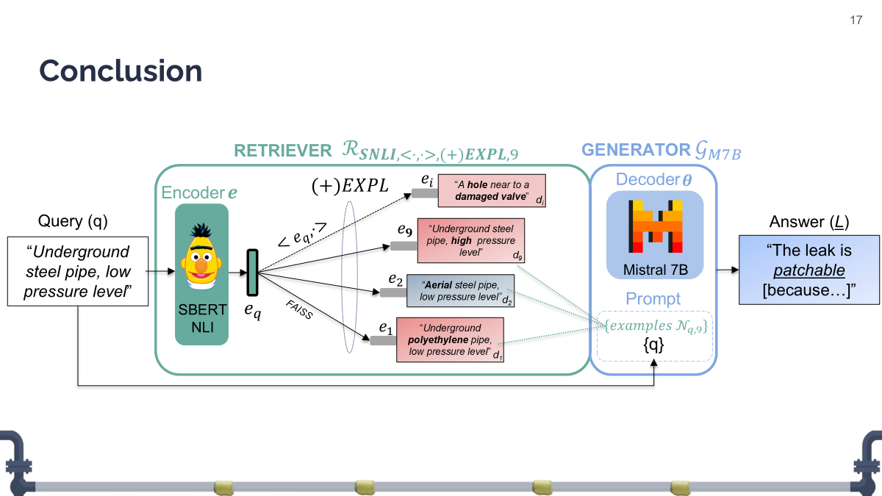

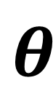
Outline
Aerial steel pipe, low pressure level
$$e$$
$$θ$$
Aerial steel pipe, high pressure level
1. Objective
2. Hypothesis
3. Methodology
4. Evaluation
5. Conclusions

Slide 3







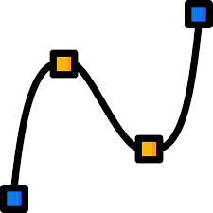
Value Proposition
Innovate
Reduce Gas Leaks Impact
Improve Safety
Notes:
BRINGING the Innov through AI- SDG 9 (Industry, Innovation, and Infrastructure):
Decision making tool to FOSTER smarter data driven solution
SUSTAINABILITY of infrastrusture on the gas industry.
REDUCING Env impact(Responsible Consumption and Production)
instd of going through an OVERALL replacement the proj
- is PROMOTING RESOURCE EFFICIENCY - REPAIR instd of REPLACeMENT
- MINIMIZING the waste of material.
- Lessening the chances of gas leaks which is helping in BETTER URBAN ENVIRONMENT. IMPROVING safety SDG 11 (Sustainable Cities and Communities)-
- Ensures safety for the workers,
- For the communities by addressing gas leaks for effectively

Slide 4



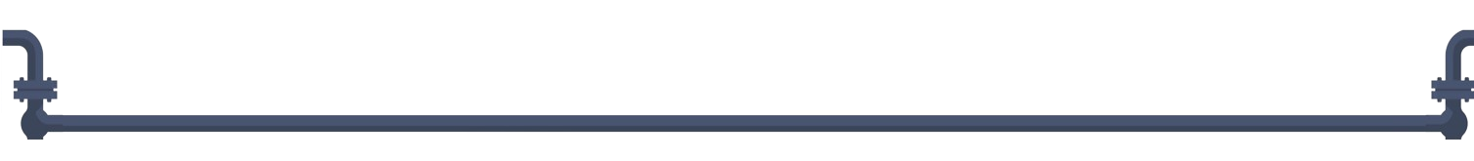
Objective
Evaluate the potential of a RAG system in developing a chatbot to assist gas fitters in the application of Patch MadFlex, a product of Composite Research (CoRe).
99% fails
History & AI
SDGs
Notes:
First Step of the Research and Innovation Pathway.
Why: patching fails 99%
Who: gasfitters,CoRe, ItalGas
How: chatbot backed by a retrieval system (Retrieval Augmented Generation RAG).
How (stakeholders' benefits): an opinion based on application history.

Slide 5
Hypothesis
A retrieval system can enhance an LLM’s performance even in low-lexical-diversity scenarios, where retrieved documents are highly similar to each other.
Aerial steel pipe, low pressure level
Aerial steel pipe, high pressure level
A. Even a single word can impact patch applicability
B. Most common words mirror feature names of the original tabular dataset.
Notes:
Heafter, BLUE patchable RED not patchable.

Slide 6
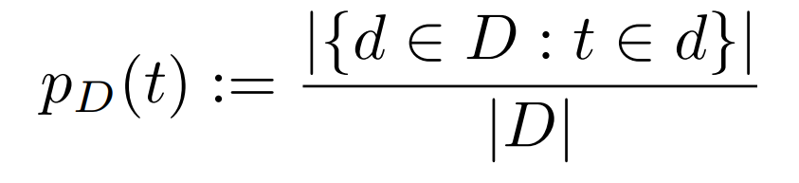
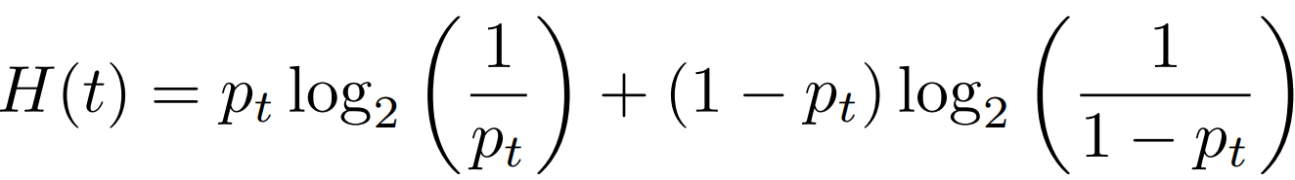
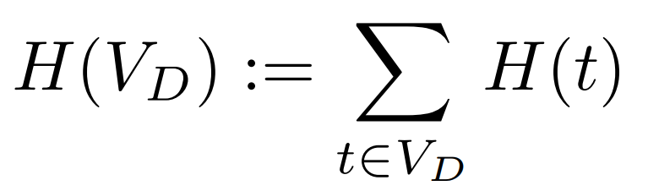
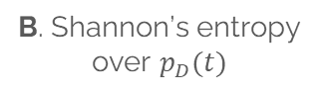
Corpus Lexical Entropy
Lexical Entropy quantifies the lexical similarity in a corpus. The metric quantifies our understanding: our corpus exhibits significantly higher document similarity than other domain-specific corpora, such as PubMed-QA.. This highlights the unique challenge of retrieval in our setting.
A. Probability of term t in document d
B. Shannon’s entropy over $p_{D}(t)$
C. Corpus Lexical Entropy
Notes:
Heafter, BLUE patchable RED not patchable.

Slide 7
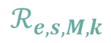
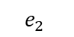
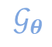
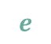
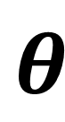

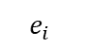
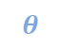
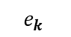
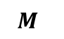
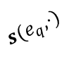
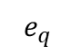
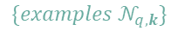
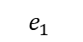
Method
Define a training-free search space $𝓢$ over RAG components $e,s,M,k, θ$ and constrain LLM’s answer to YES or NO through the prompt to facilitate evaluation.
RETRIEVER
$$ℛ_{e,s,M,k}$$
GENERATOR
$$𝒢_{θ}$$
$$e_{i}$$
Decoder
$$e$$
$$M_{ }$$
“A hole near to a damaged valve”
$$θ$$
Encoder
d_{i}
$$θ$$
Query (q)
$$e_{k}$$
Answer (L)
$$e$$
$$s(e_{q},⋅)$$
“Underground steel pipe, high pressure level”
Underground steel pipe, low pressure level
d_{k}
The leak is patchable [because…]
$$e_{2}$$
“Aerial steel pipe, low pressure level”
Prompt
$$e_{q}$$
_{FAISS}
d₂
$$e_{1}$$
“Underground polyethylene pipe, low pressure level”
$$\{examples 𝒩_{q,k}\}$$
{q}
d₁
Skeleton of the RAG system in object of this study.

Slide 8
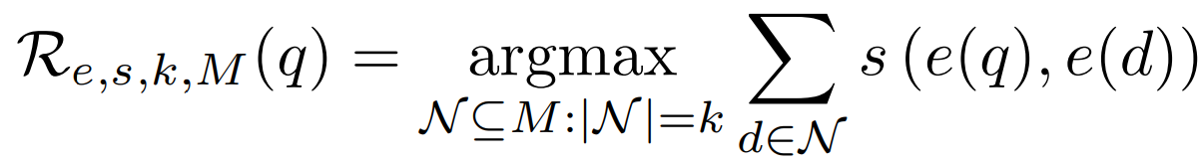
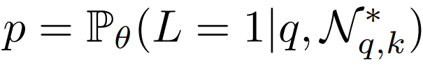
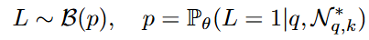

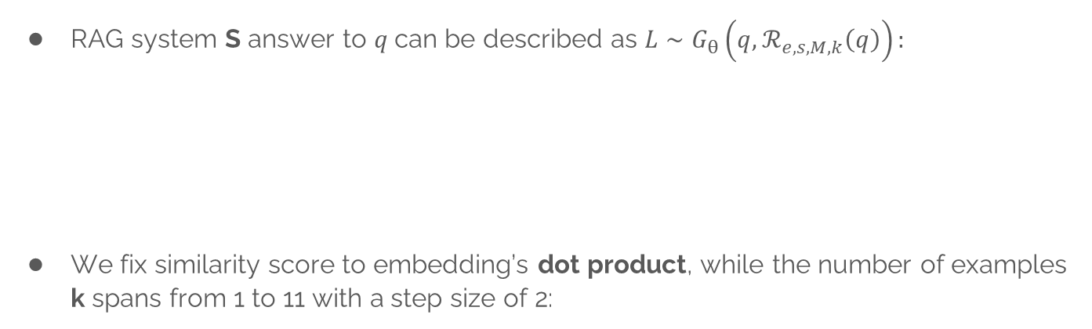
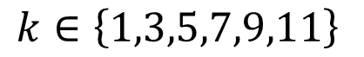
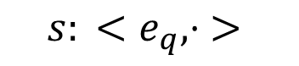
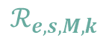
Method: formalization, similarity $s$and $k$
RAG system S answer to $q$can be described as $L∼G_{θ}\left(q,ℛ_{e,s,M,k}\left(q\right)\right):$
We fix similarity score to embedding’s dot product, while the number of examples k spans from 1 to 11 with a step size of 2:
Query
RETRIEVER
$$ℛ_{e,s,M,k}$$
GENERATOR
$$𝒢_{θ}$$
Answer
q
L
$${s: <e}_{q}, ⋅ >$$
$$k∈\left\{1,3,5,7,9,11\right\}$$
A. Inner Product
B. Number of examples
Notes:
Our hypotesis mathematically stands that adding R to G

Slide 9
Method: encoder $e$
Adjectives and negations significantly influence reparability: SNLI models are trained to detect logical relationships between sentences.
Aerial steel pipe, high pressure level
S
d_{A}
C
Aerial steel pipe, low pressure level
!S
q
N
d_{B}
Underground steel pipe, low pressure level
A. NLI (Entail, Neutral, Contradict) vs Semantic Similarity STS ([!]Similar)
Notes:
Our hypotesis mathematically stands that adding R to G

Slide 10
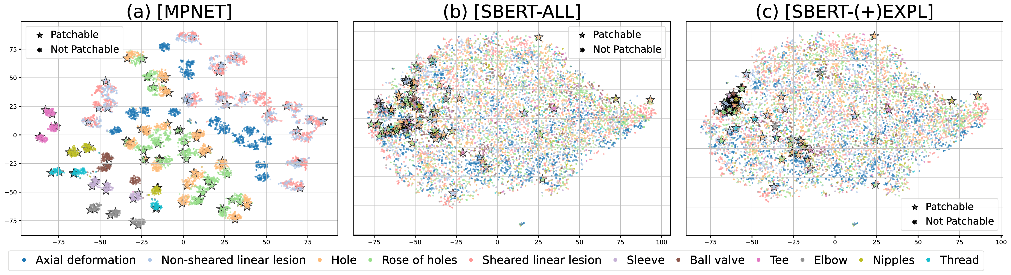
Method: encoder $e$
Adjectives and negations significantly influence reparability: SNLI models are trained to detect logical relationships between sentences. We expect SBERT-NLI outstanding state-of-the-arts STS models.
Aerial steel pipe, high pressure level
S
d_{A}
C
Aerial steel pipe, low pressure level
!S
q
N
d_{B}
Underground steel pipe, low pressure level
A. NLI (Entail, Neutral, Contradict) vs Semantic Similarity STS ([!]Similar)
B. t-SNE visualization of embedding spaces. SBERT accumulates patchable points closely.
Notes:
Our hypotesis mathematically stands that adding R to G

Slide 11
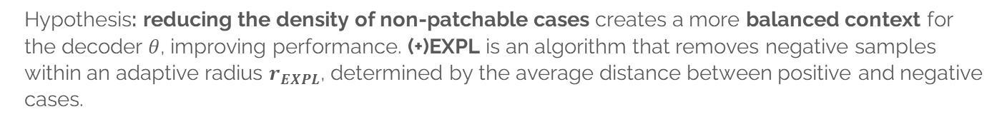
Method: Memory $M$
Hypothesis: reducing the density of non-patchable cases creates a more balanced context for the decoder $θ$, improving performance. (+)EXPL is an algorithm that removes negative samples within an adaptive radius $r_{EXPL}$, determined by the average distance between positive and negative cases.
-
-
-
-
-
-
-
-
-
-
-
-
-
-
-
-
-
+
-
-
-
-
-
-
-
-
-
-
-
-
-
-
-
-
-
-
-
Notes:
Our hypotesis mathematically stands that adding R to G

Slide 12
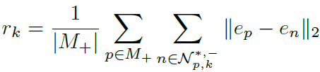
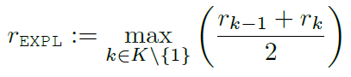

Method: Memory $M$
Hypothesis: reducing the density of non-patchable cases creates a more balanced context for the decoder $θ$, improving performance. (+)EXPL is an algorithm that removes negative samples within an adaptive radius $r_{EXPL}$, determined by the average distance between positive and negative cases.
-
-
-
-
-
-
-
-
-
-
-
-
-
-
-
-
-
-
-
-
-
-
-
-
-
-
$$r_{EXPL}$$
-
-
-
-
+
-
-
-
+
-
-
-
-
-
-
-
-
-
-
-
-
-
-
-
-
-
-
-
-
-
-
-
-
-
-
-
-
-
-
-
-
-
A. Overcrowded positive point [ALL]
B. Overcrowded positive point [(+)EXPL]
C. Explosion range definition
Notes:
Our hypotesis mathematically stands that adding R to G

Slide 13
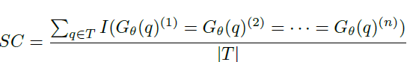
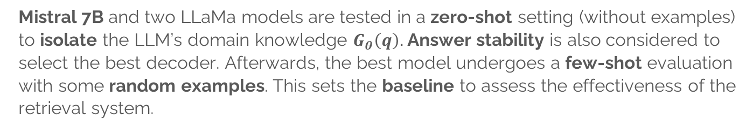
Method: decoder $θ$.
Mistral 7B and two LLaMa models are tested in a zero-shot setting (without examples) to isolate the LLM’s domain knowledge $G_{θ}\left(q\right).$ Answer stability is also considered to select the best decoder. Afterwards, the best model undergoes a few-shot evaluation with some random examples. This sets the baseline to assess the effectiveness of the retrieval system.
Self Consistency: measures answer’s stability across n runs.
Notes:
Our hypotesis mathematically stands that adding R to G

Slide 14



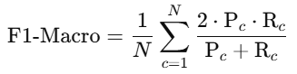
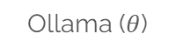

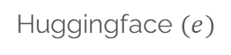
Evaluation
This project was developed on a Jupiter Notebook in Python:
F1-MACRO allows a fair evaluation of the system on both labels:
$$e$$
CoLab (T4)
Huggingface $(e)$
Ollama ($θ$)
F1-MACRO
Notes:
Our hypotesis mathematically stands that adding R to G

Slide 15

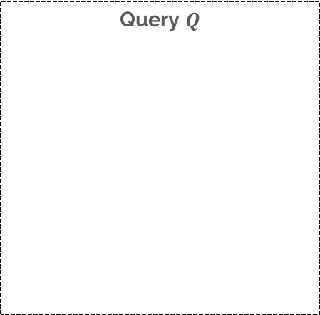
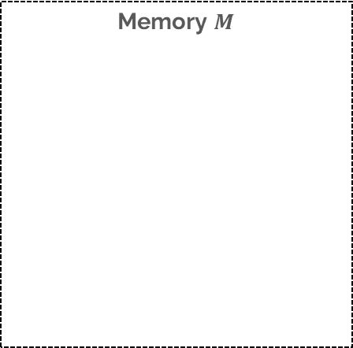


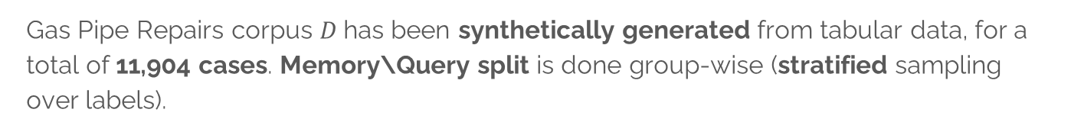

Evaluation: Dataset, $M$s and $Q$s.
Gas Pipe Repairs corpus $D$has been synthetically generated from tabular data, for a total of 11,904 cases. Memory\Query split is done group-wise (stratified sampling over labels).
Query $Q$
Corpus
Memory $M$
F
11778
9422
8904
20%
80%
-518
-2246
2356
T
126
100
101
101
25
25
$$Q_{d}$$
$$Q$$
D
$$M_{ALL}$$
$$M_{EXPL}$$
Notes:
Our hypotesis mathematically stands that adding R to G

Slide 16
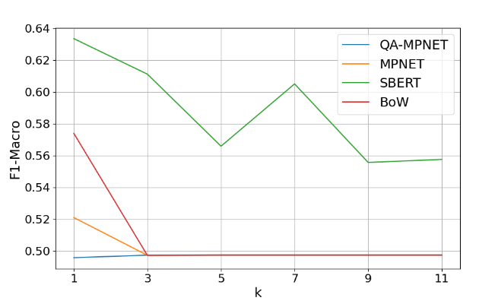
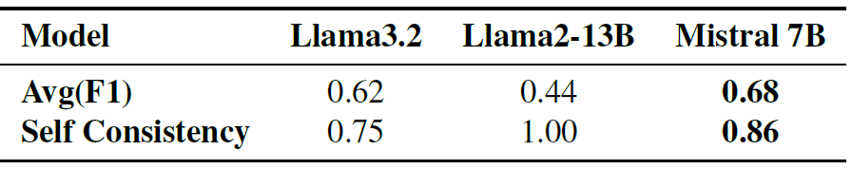
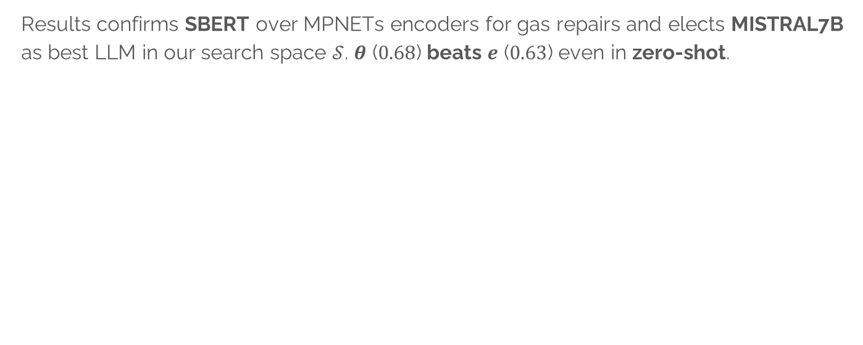
Evaluation: $e$ and $θ$
Results confirms SBERT over MPNETs encoders for gas repairs and elects MISTRAL7B as best LLM in our search space $𝒮$. $θ$ ($0.68$) beats $e$ ($0.63$) even in zero-shot.
Decoders (zero-shot)
Encoders (k-NN)

Slide 17
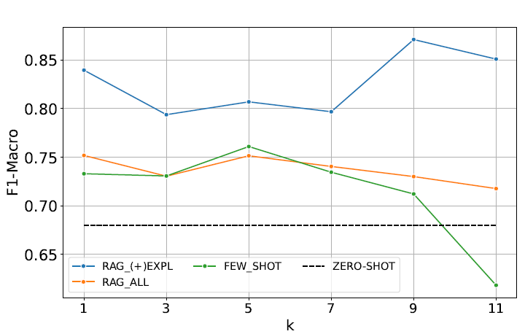
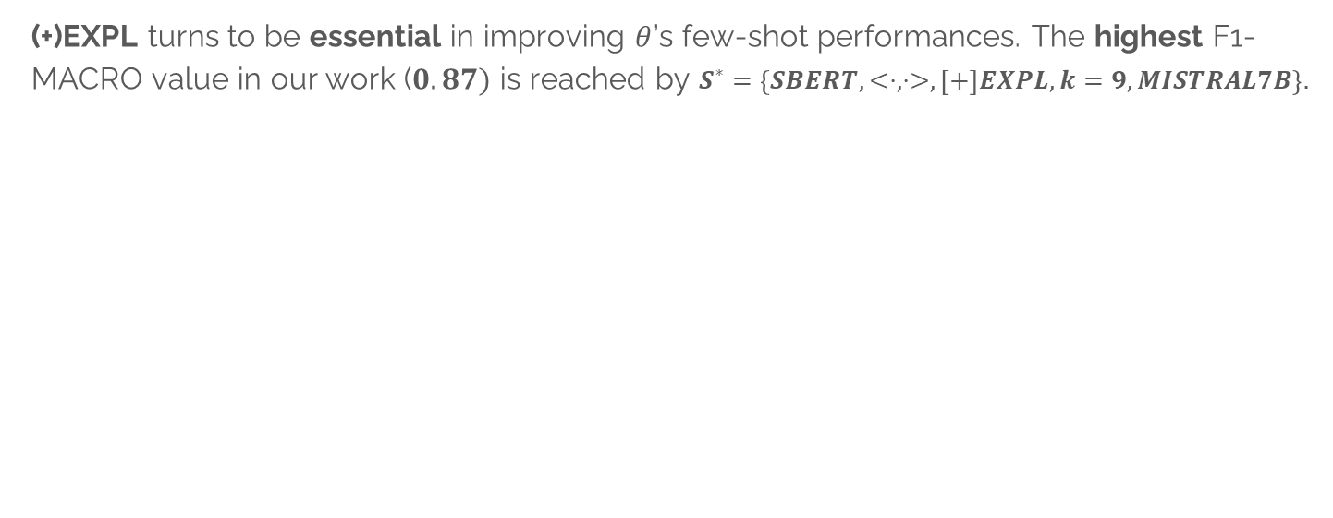
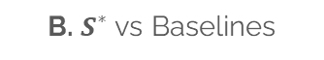

Evaluation: RAG Systems and best solution $S^{∗}$
(+)EXPL turns to be essential in improving $θ$’s few-shot performances. The highest F1-MACRO value in our work ($0.87)$ is reached by $S^{∗}=\left\{SBERT, <⋅, ⋅>,\left[+\right]EXPL,k=9,MISTRAL7B\right\}.$
$$S^{∗}$$
A. RAG with (+)EXPL (in blue) outstands for any k.
B. $S^{∗}$ vs Baselines

Slide 18
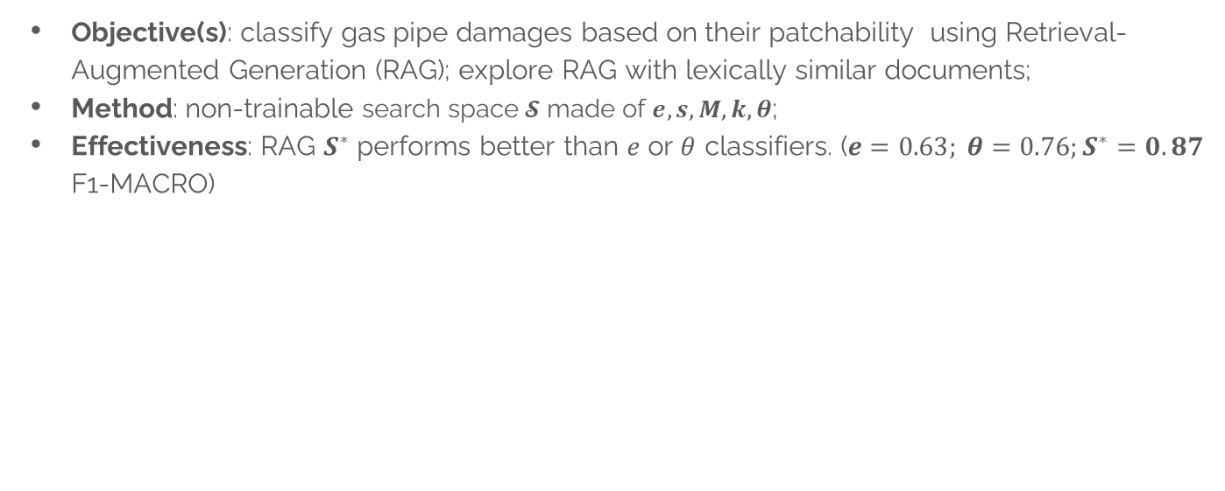
Conclusion
Objective(s): classify gas pipe damages based on their patchability using Retrieval-Augmented Generation (RAG); explore RAG with lexically similar documents;
Method: non-trainable search space $𝓢$ made of $e,s,M,k, θ$;
Effectiveness: RAG $S^{∗}$ performs better than $e$ or $θ$ classifiers. ($e=0.63; θ=0.76;S^{∗}=0.87$ F1-MACRO)
$S^{∗}$ : the best configuration explored in this work
Notes:
Our hypotesis mathematically stands that adding R to G

Slide 19
THANK YOU!
Grazie!
ধন্যবাদ
شکریہ
Notes:
Bengalese: dhonnobaad
Urdu: shukrya

